Slide 1



Slide 2

A simple online knowledge sharing portal designed to discuss and share the educational articles among university students.

Slide 3

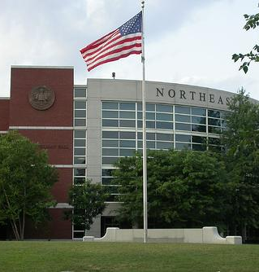
Contents
Project Statement
Functionalities
Use cases
Technologies
Future Scope
References

Slide 4

Project Statement
Husky-Learn is an application that will provide students to share their experiences and knowledge gained about the courses they have pursued while graduating. This is a hassle-free application that will allow users to post new articles and read other articles posted by other users, follow the other users, add the articles to their favorite list.

Slide 5

Functionalities
Login and Registration
Post Articles
View Posted Articles
Update Posted Articles
View Favourite Articles
View other User Profiles
Update Profile
Post a comment
Delete a comment

Slide 6
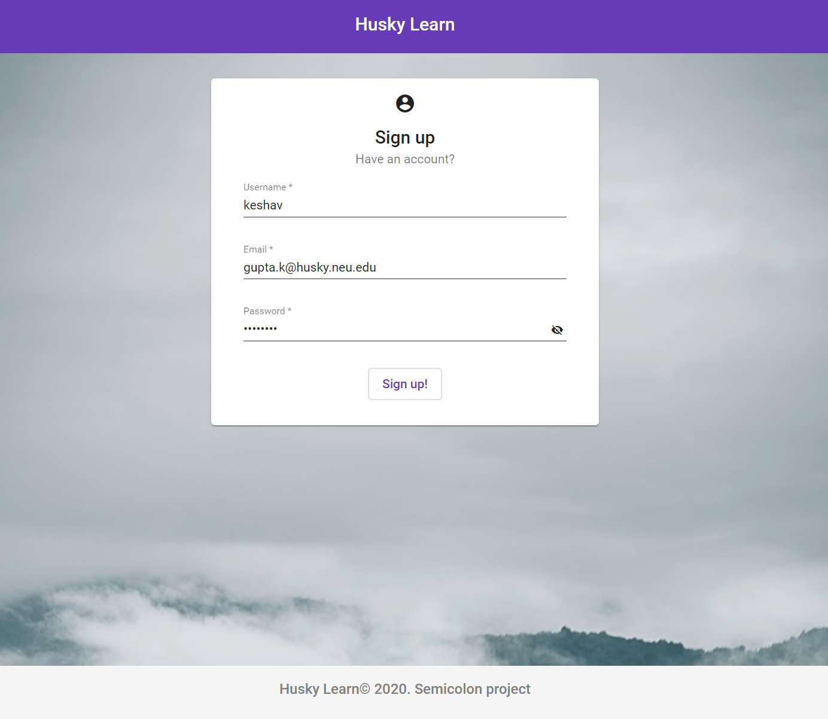
Sign Up
User is able to Register to the application successfully.

Slide 7
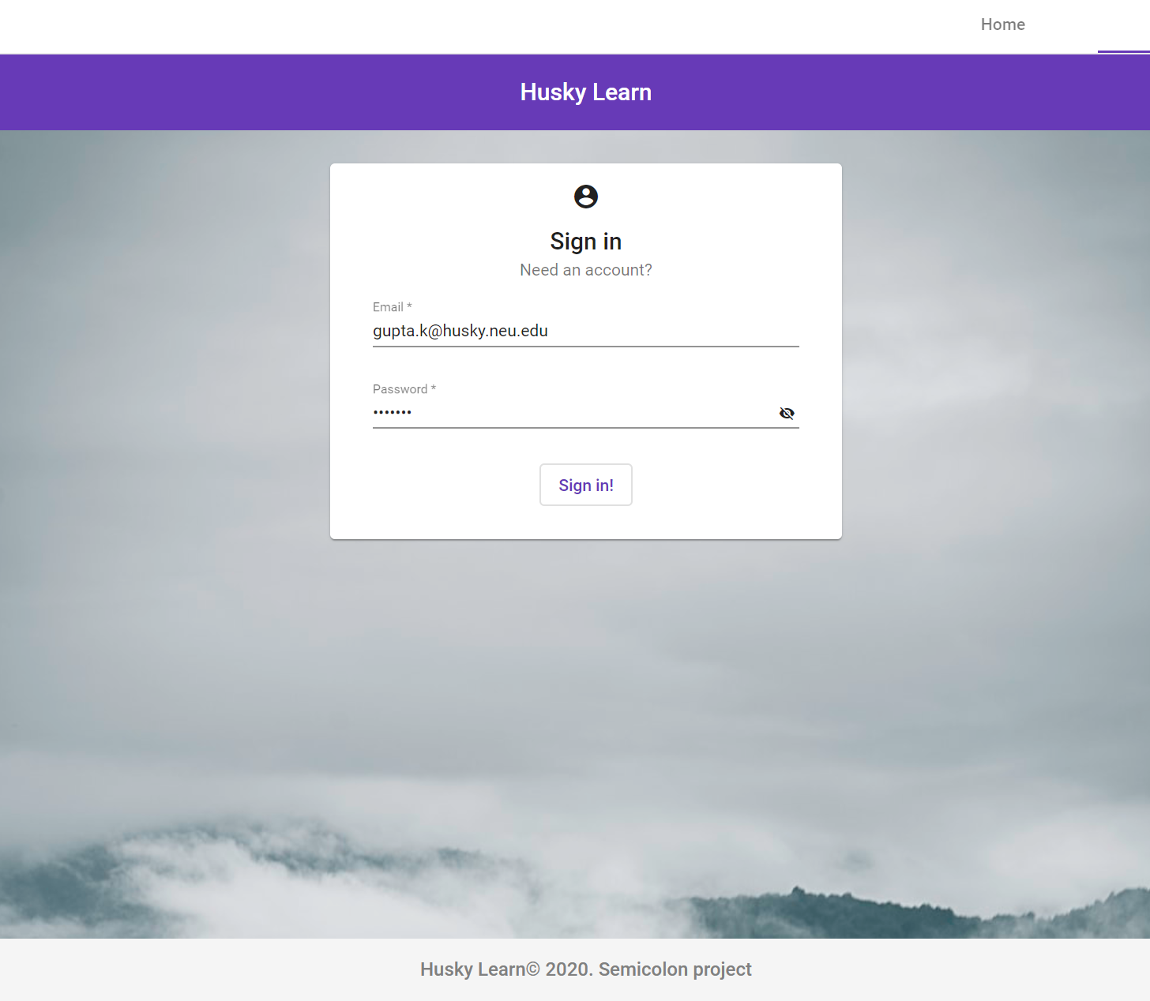
Sign In
After Signing Up user is able to login for proceeding with the further actions.

Slide 8
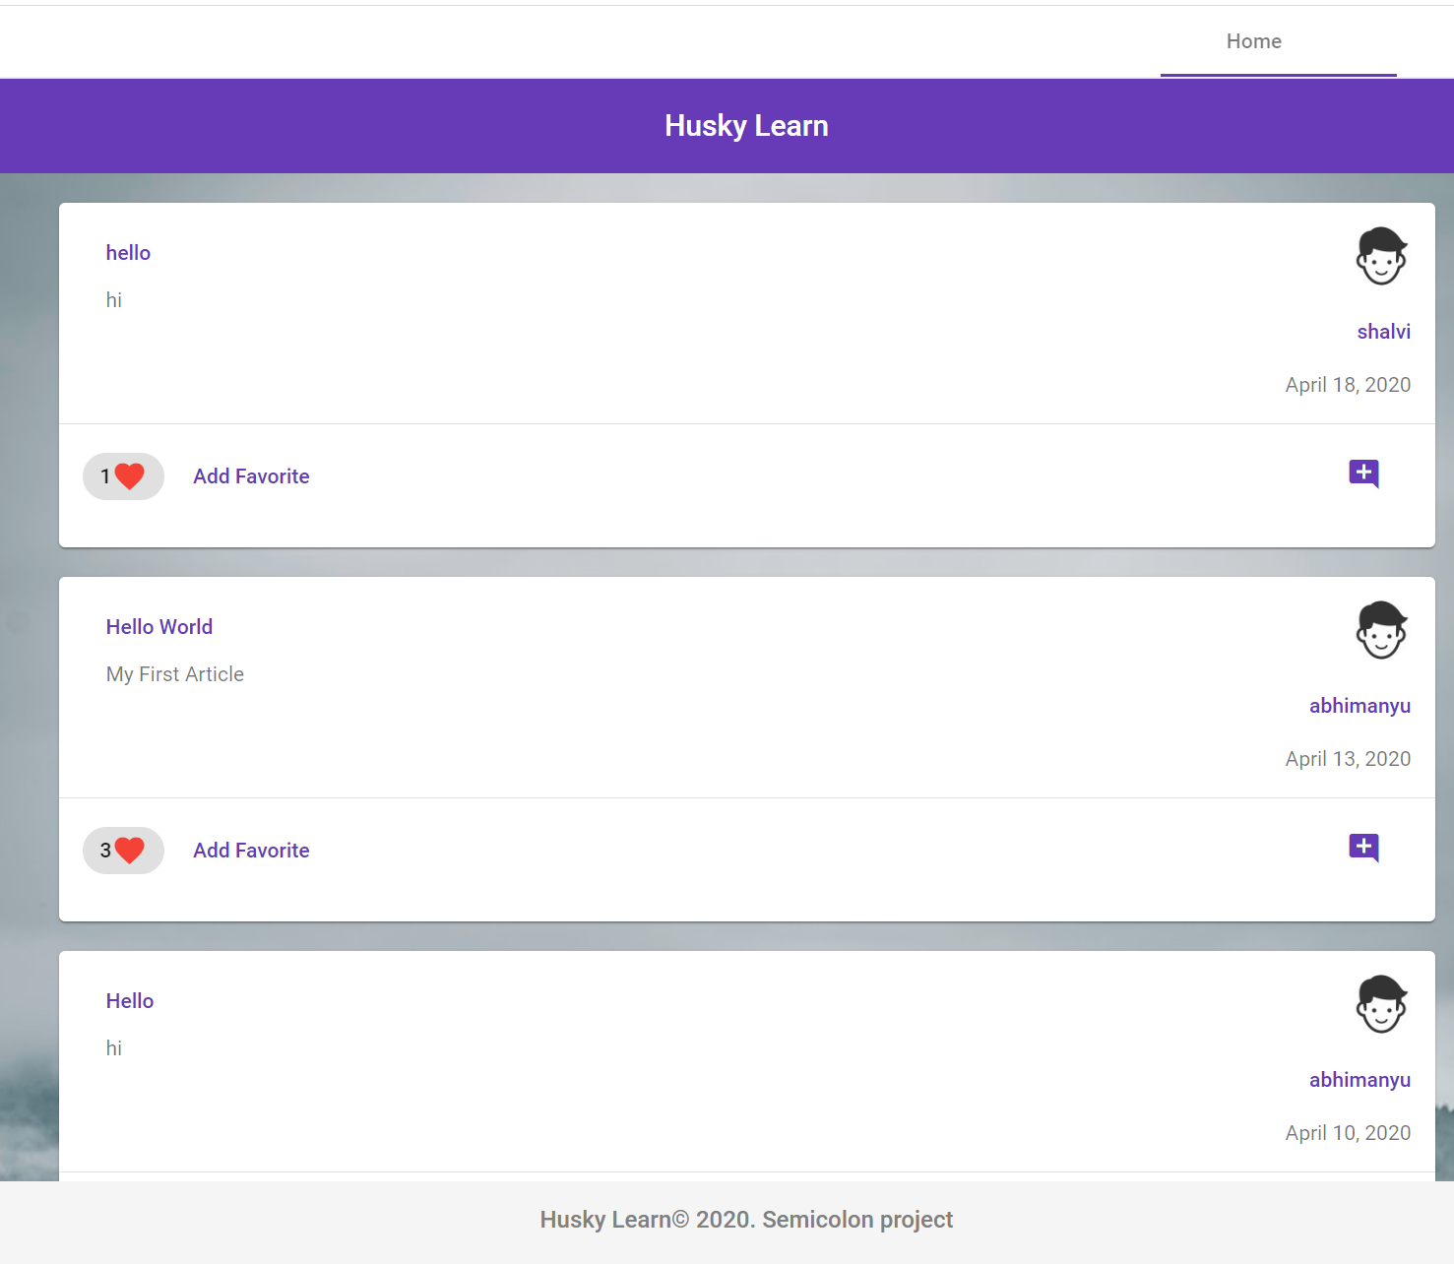
Home Page
User can see all the posts on the home page but cannot comment and add the post to their favorites before signing up.

Slide 9
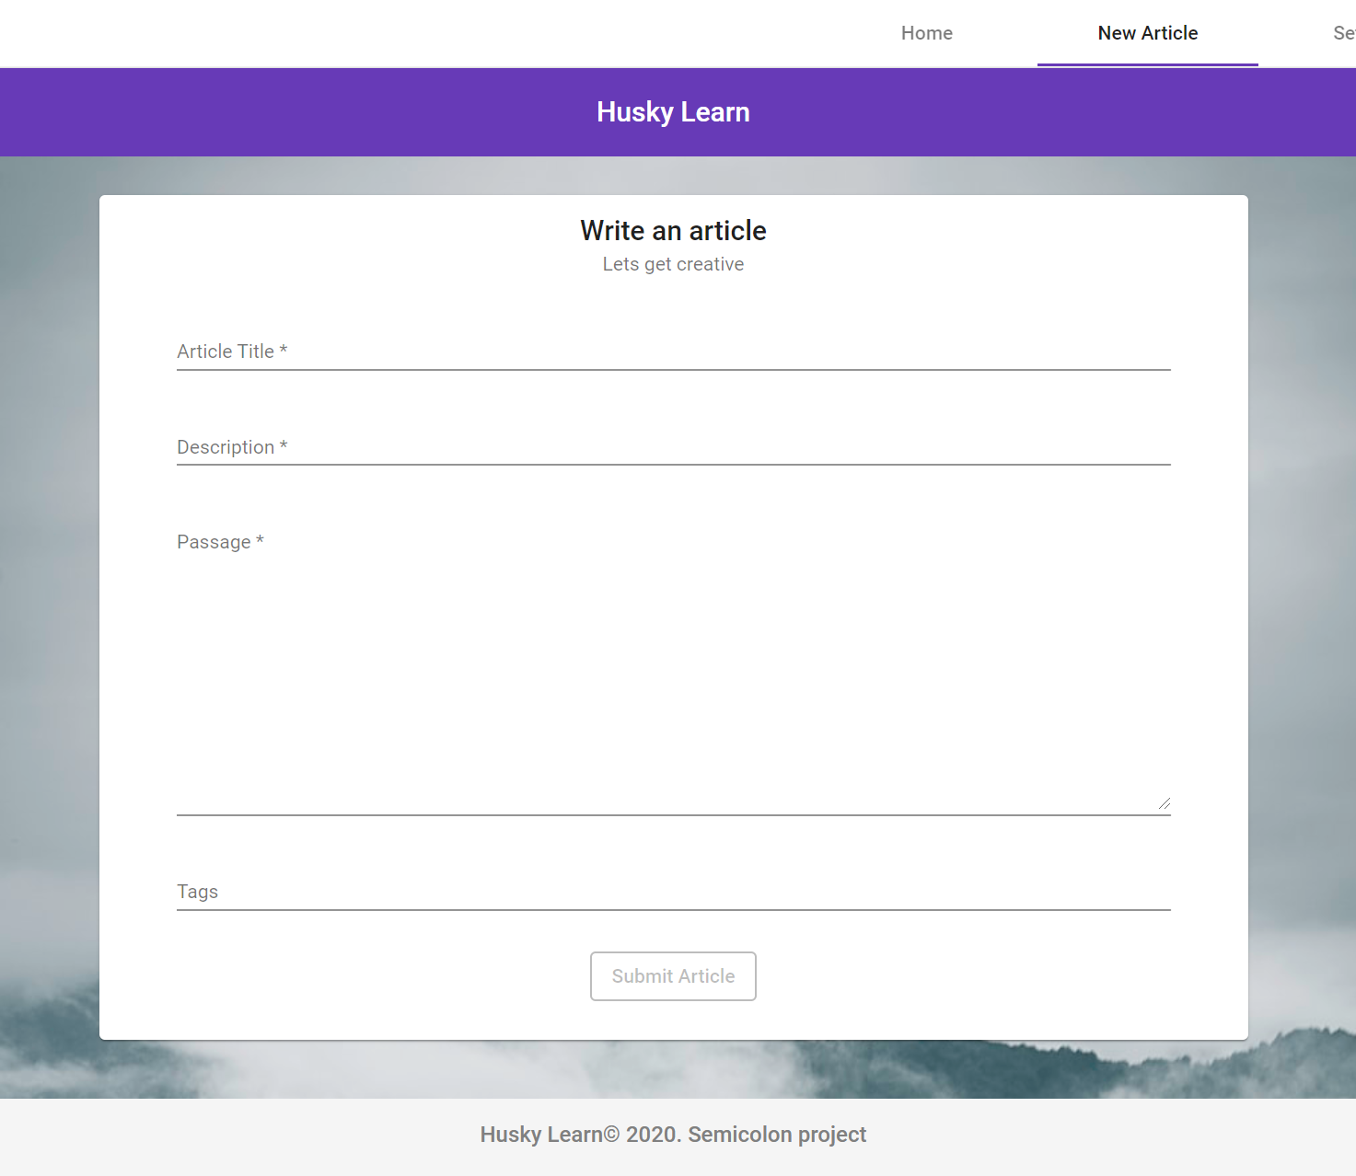
Post Articles
User is able to post articles here.
User must enter the article title, description and the passage. To submit the article.

Slide 10
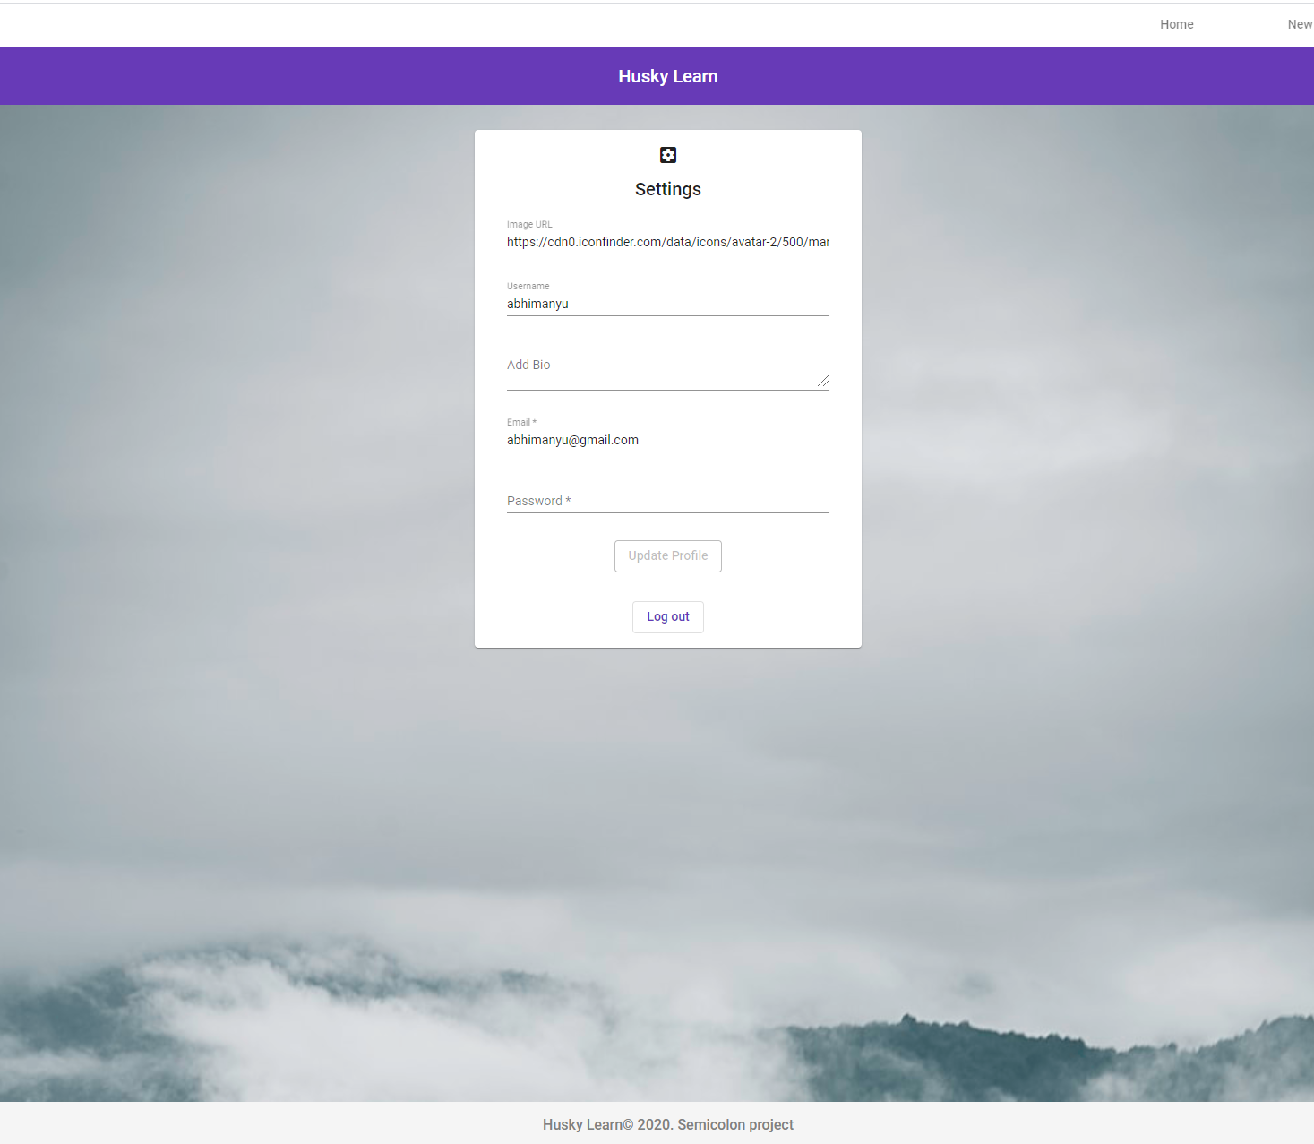
Profile settings
User is able to update his profile.
User can add bio, change password, and profile image.
User can logout from here as well.

Slide 11
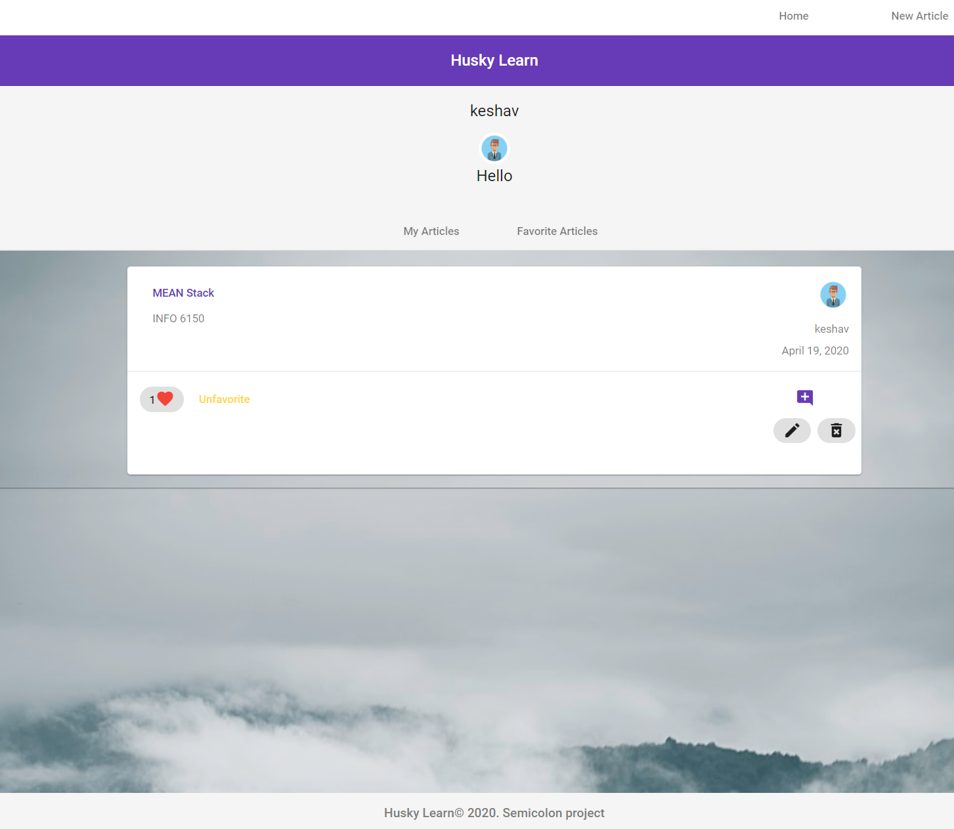
User Profile Page
User can navigate to his profile page.
User can see what he has posted in My Articles.
User can see all the articles he has favorited in Favorite Articles.
User can also edit their articles and as well as delete them.

Slide 12
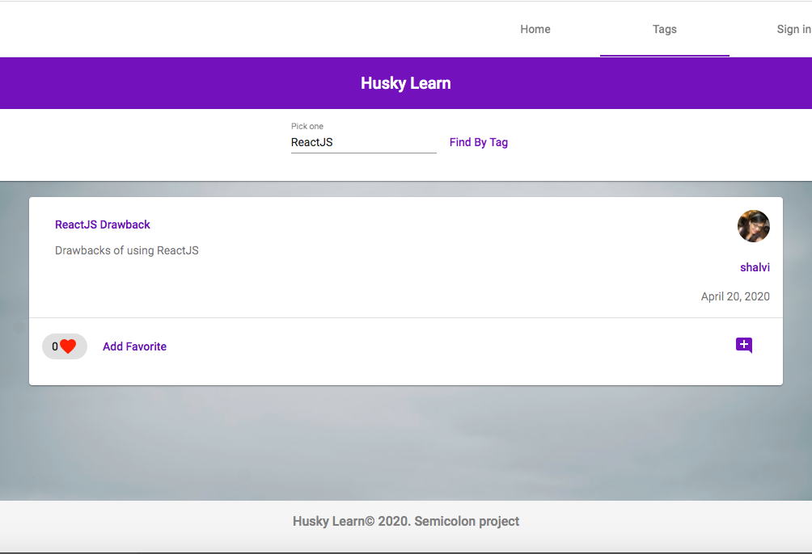
Search By Tags
User can search articles using tags.

Slide 13

Technologies
Backend
NodeJS
ExpressJS
MongoDB, Mongoose
JWT
Frontend
Angular
Angular Material
SCSS
This Photo by Unknown Author is licensed under CC BY-SA-NC

Slide 14

Future Scope
Implementing direct messaging between users who follow each other.
Implementing user search by username.

Slide 15

References
https://www.sitepoint.com/user-authentication-mean-stack/
https://www.djamware.com/post/5b00bb9180aca726dee1fd6d/mean-stack-angular-6-crud-web-application
https://www.positronx.io/angular-jwt-user-authentication-tutorial/
https://loiane.com/2017/08/angular-hide-navbar-login-page/

Slide 16

Members
Shalvi Kubal
Sumesh Harale
Vardhana Vinod Bhatt
Keshav Gupta

Slide 17



THANK YOU
https://github.com/neu-mis-info6150-spring-2020/final-project-semicolon

